Slide 1

Single-Stage Rocket (SSR)
Avionics Instructions

Slide 2
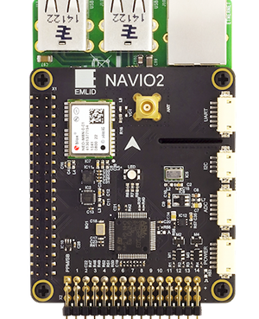
Raspberry Pi and Navio2 Configuration
Avionics Kit
Power Supply
Putty – Installation Instructions Attached
SD Card Reader
Internet Connection
Notes:
https://docs.emlid.com/navio2/

Slide 3
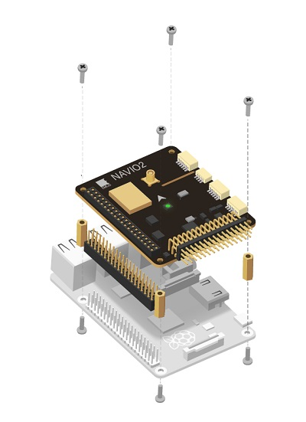
Step 0
Physical Assembly
0.1
Install Spacers to the top of the Raspberry Pi
0.2
Connect extension header to Raspberry Pi GPIO Port
0.3
Attach NAVIO2 To Extension Header
0.4
Install Screws to spacers
Notes:
https://ardupilot.org/copter/docs/common-navio2-wiring-and-quick-start.html

Slide 4
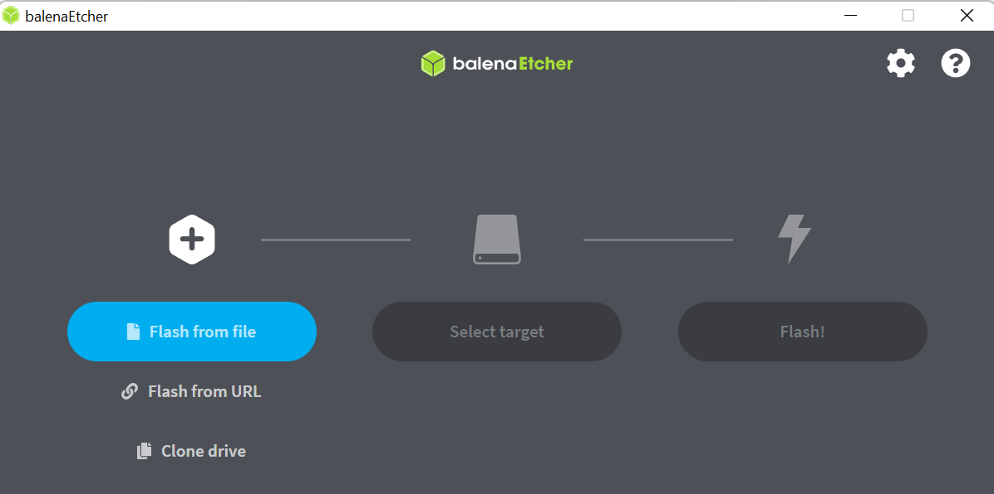
Step 1
Download Essential Software – Balena Etcher
1.1
Balena Etcher is an open-source utility used to write system images to storage media such as a Flash Drive or SD Card. We will use this to place the operating system of our Raspberry Pi, called Raspbian, onto an SD card that can be inserted into the Pi.

Slide 5
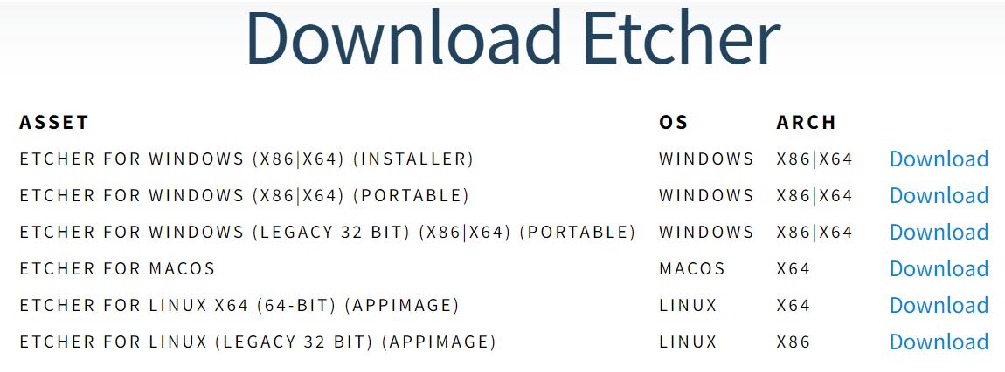
Step 1
Download Essential Software – Balena Etcher (Cont.)
1.2
Navigate to the Install Page for Etcher https://www.balena.io/etcher
1.3
Select the Version for your Operating System

Slide 6
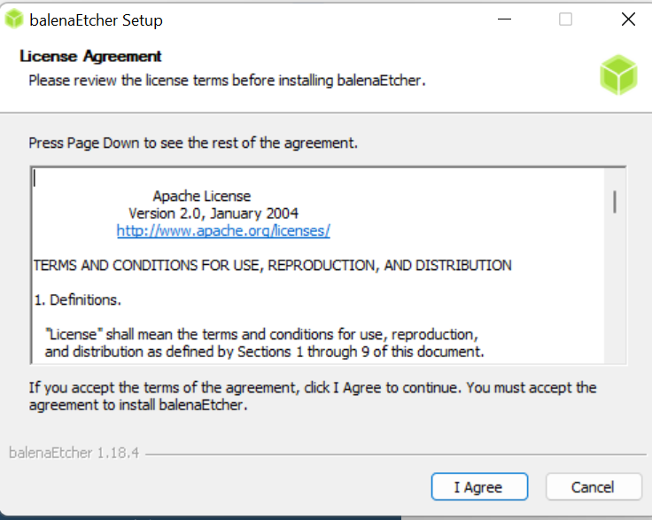
Step 1
Download Essential Software – Balena Etcher (Cont.)
1.4
Read the Terms of Agreement and select Agree

Slide 7
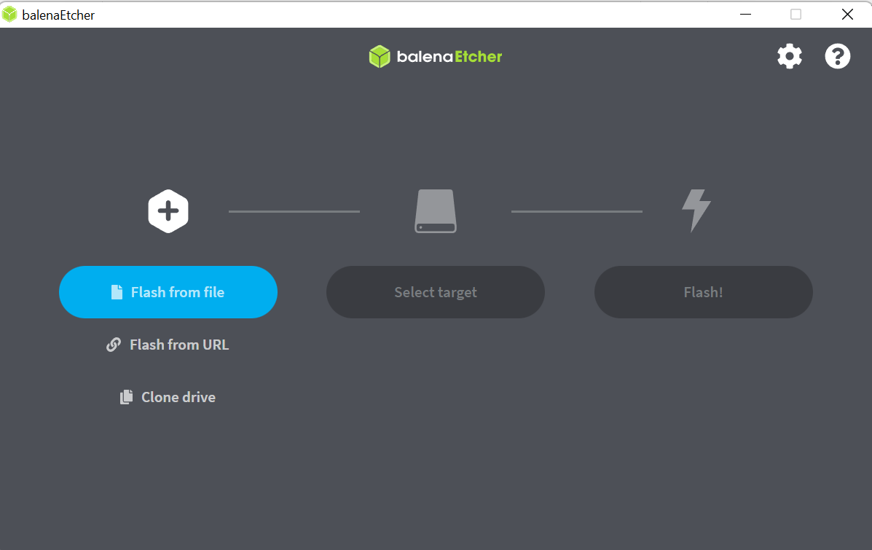
Step 1
Download Essential Software – Balena Etcher (Cont.)
1.5
Wait for the download to finish, afterwards it will open up the Etcher Software

Slide 8
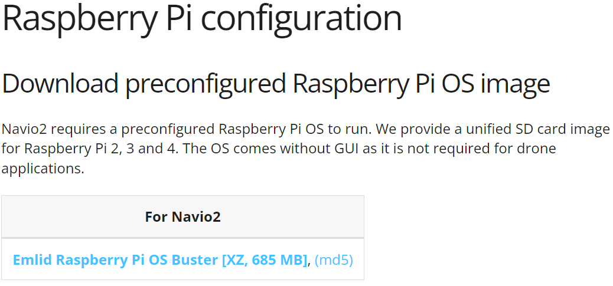
Step 2
Download Essential Software – Navio2 OS
2.1
With Balena, we now need a copy of the operating system we plane to use. Thankfully, the developers of the Navio2 have created a pre-configured operating system. All we need to do is download it and write the image to the SD card.
2.2
Download OS Here: https://docs.emlid.com/navio2/configuring-raspberry-pi Note: This is a larger file so it may take several minutes to download
After it is finished, you should have a “.img.xz” file in your download folder. This is your image.

Slide 9
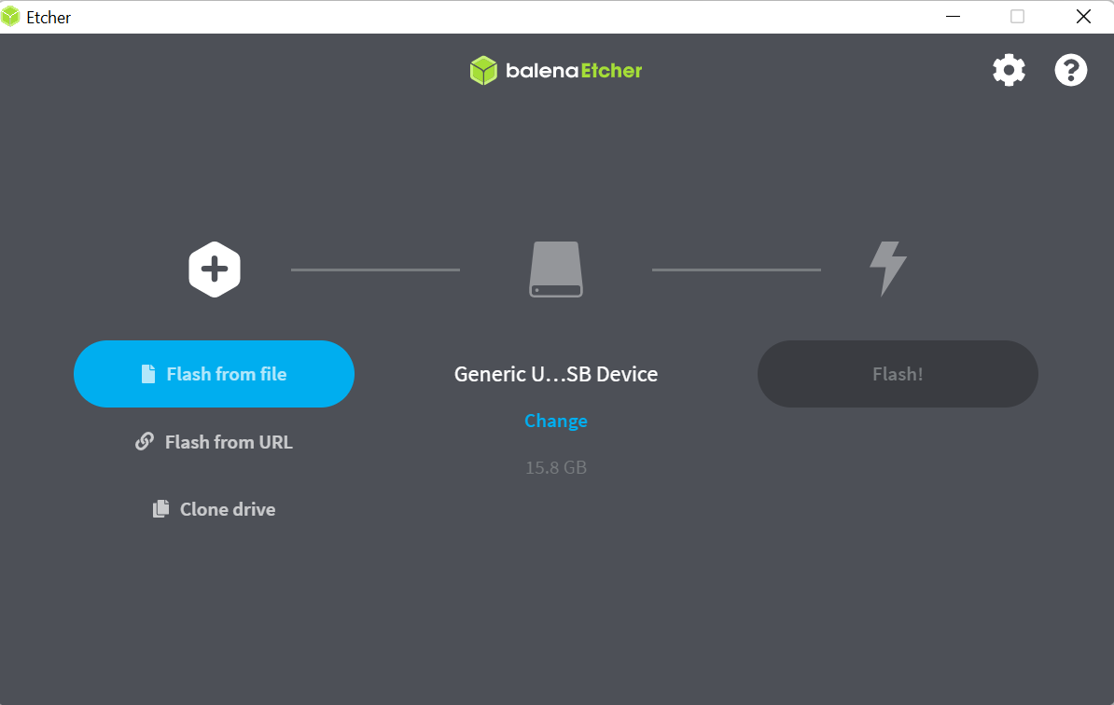
Step 3
Flashing the Operating System to a SD Card
3.1
Now that we have both the writing software and the image, we can flash our SD card using the downloaded image. Flashing refers to the process of writing the contents of an image file to an SD file.
3.2
Open Balena Etcher if not already open, plug in SD Card to Computer

Slide 10
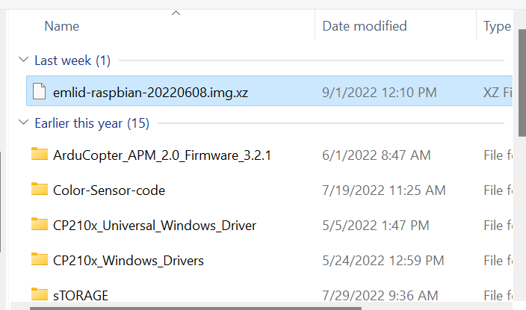
Step 3
Flashing the Operating System to a SD Card (Cont.)
3.3
Select the Navio2 Image that you downloaded in Step 2

Slide 11
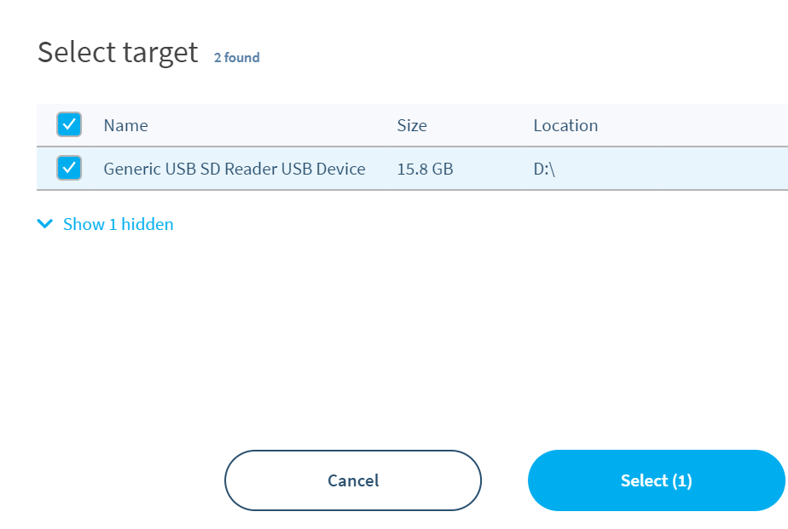
Step 3
Flashing the Operating System to a SD Card (Cont.)
3.4
Select the SD Card you wish to flash

Slide 12
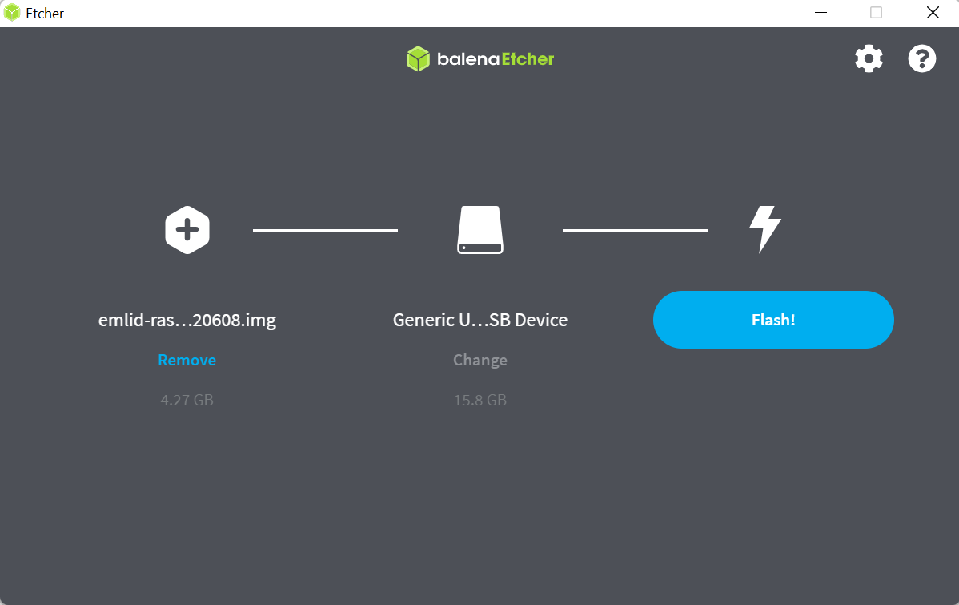
Step 3
Flashing the Operating System to a SD Card (Cont.)
3.5
Begin Flashings by selecting the Flash Button

Slide 13
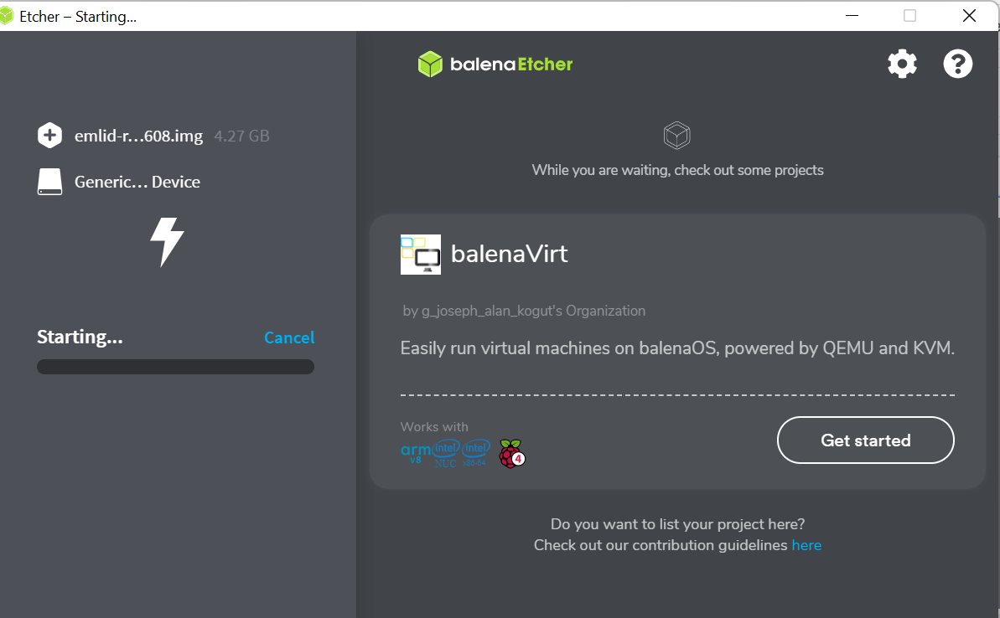

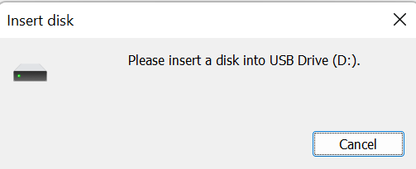
Step 3
Flashing the Operating System to a SD Card (Cont.)
3.6
Wait for Flashing to Finish
A pop up will appear saying to please insert a disk into USB Drive, do not do anything with these windows. They appear naturally during the flashing process and will disappear.

Slide 14
Step 4
Wi-Fi Configuration
4.1
Now that we have our image created, we need to configure our internet connection so that the Raspberry Pi will connect to your network on boot-up. This makes extracting data and setting up the Raspberry pi easier as you can then do it from your computer rather than using a second monitor and keyboard connected to the Raspberry Pi.

Slide 15
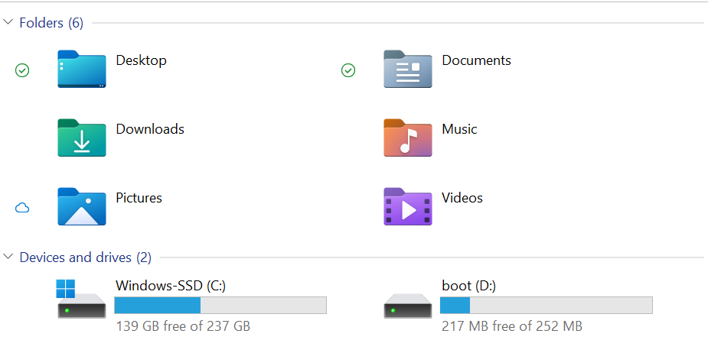
Step 4
Wi-Fi Configuration (Cont.)
4.2
With your SD card still connected to your computer, open up your file viewer and navigate to your available devices and drives.
4.3
Open the Boot Driver

Slide 16
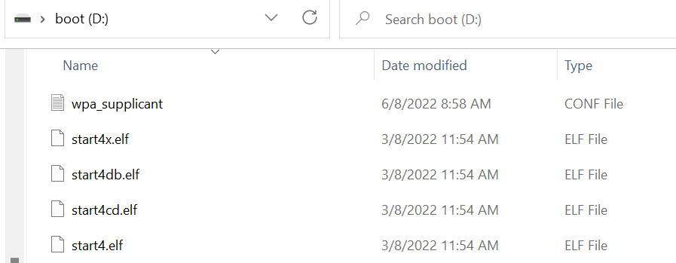
Step 4
Wi-Fi Configuration (Cont.)
4.4
Navigate to the Boot Drive and open the WPA_supplicant file using a text editor such as Notepad

Slide 17
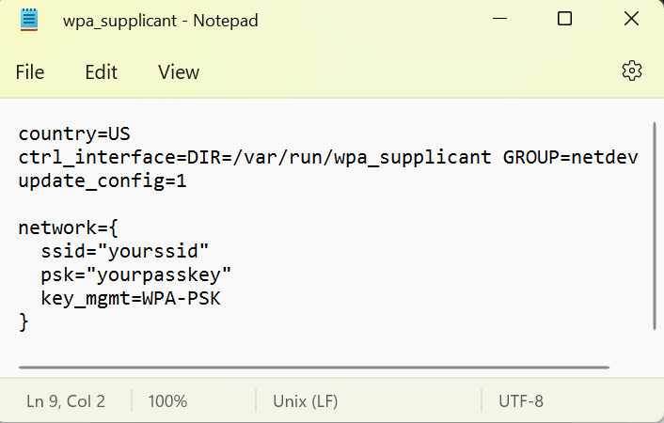
Step 4
Wi-Fi Configuration (Cont.)
4.5
Your file should match the provided example.
Place your Wi-Fi name and password INSIDE the quotation marks, do not get rid of the quotation marks.
4.6
Save and close the file.
Eject the SD Card from the Computer

Slide 18
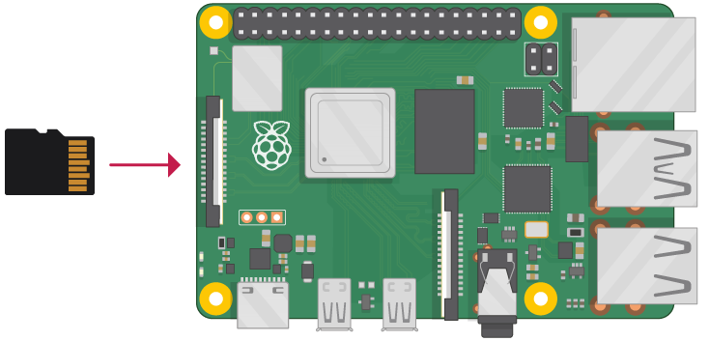
Step 5
Ardupilot Configurations
5.1
This will walk through on setting up the software side of the Navio2 before connecting to mission planner
5.2
First, install the SD Card into the Raspberry Pi and connect Power to the Navio2
Notes:
https://projects.raspberrypi.org/en/projects/raspberry-pi-setting-up/3

Slide 19
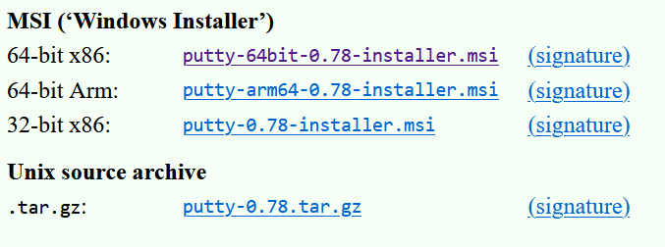
Step 5
Ardupilot Configurations (Cont.)
5.3
In order to configure the software configurations, we need to be able to connect to the Raspberry Pi. You can do this by simply connecting a Monitor and Keyboard to it, but we are looking at being able to make these changes remotely using internet access.
5.4
Install Putty Here: https://www.chiark.greenend.org.uk/~sgtatham/putty/latest.html Scroll down to the “Package Files” section and select the installer that fits your system.

Slide 20
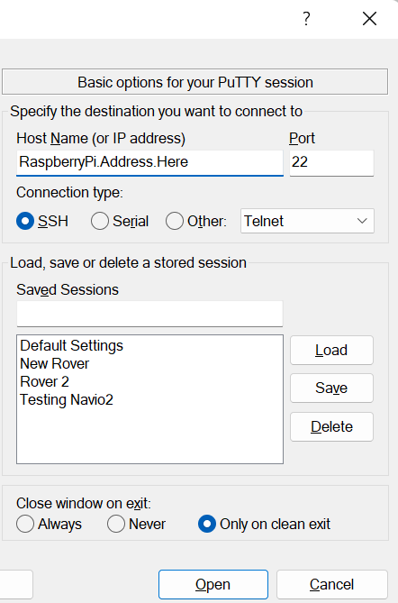
Step 5
Ardupilot Configurations (Cont.)
5.5
Once you have the software installed, you need to know the IP address of your Raspberry Pi. You can do this by either looking at the devices connected to your router, , by manually finding the IP address by connecting a Monitor/Keyboard to the Raspberry Pi and using the command “hostname –I”
Or, if you only have one Navio2 powered on, you can enter the default hostname “navio2”
If your navio2 has had the hostname changed, you can also find it labeled on the side of the Avionics Bay.

Slide 21
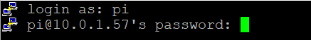
Step 5
Ardupilot Configurations (Cont.)
Enter the IP Address into the “Host Name” tab of Putty, then click Open. You will be prompted to enter the Username and Password of the Raspberry Pi.
Username: pi
Password: raspberry
When typing in the password, you will notice nothing appears. This is normal. Simply hit enter after inputting the password and if done correctly you will login.
5.6

Slide 22
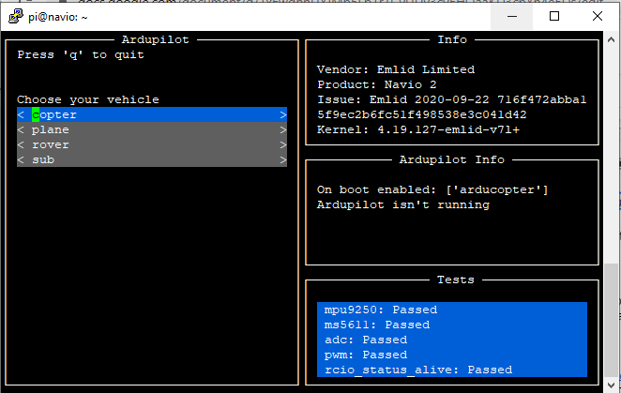
Step 5
Ardupilot Configurations (Cont.)
5.7
Once you are connected to the Raspberry Pi Enter the command “sudo emlidtool ardupilot”
This will take you into the Ardupilot setup tool
5.8
This window will appear

Slide 23
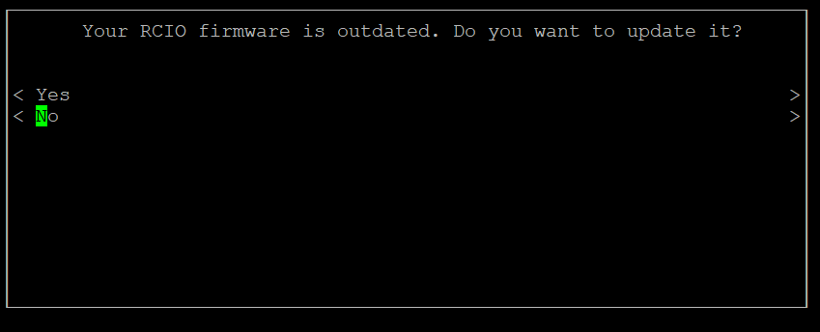
Step 5
Ardupilot Configurations (Cont.)
5.8
You might also see this pop-up, select “No” and hit Enter using the keyboard.

Slide 24
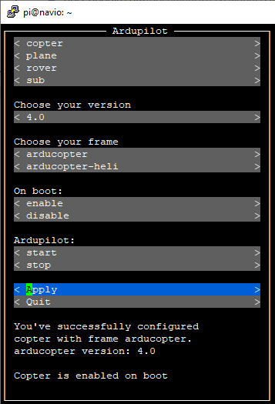
Step 5
Ardupilot Configurations (Cont.)
5.9
Now you will select the vehicle you are using along with version, an enable on boot. For the Single Stage Rocket, the following parameters to select:
Ardupilot: Copter, select the Arducopter configuration
Version: 4.0, There should only be one option here, but this is the version of Arducopter you wish to use
Frame: Arducopter, This is a different frame type compared to the Heli frame
On Boot: Enable, this will have Ardupilot start when power is applied
Ardupilot: Start, this will start the Ardupilot program now rather than waiting for power reboot
5.10
Select Apply and then press “q” to quit or hit “Quit”

Slide 25
Step 6
Telemetry Configurations
6.1
Now that we have the Ardupilot setup, we can configure the Telemetry settings for our flight controller to operate with our radios to enable ground station communication.
6.2
To adjust the settings, enter the command “sudo nano /etc/default/arducopter”
This will open the configuration file for just the Arducopter configuration

Slide 26
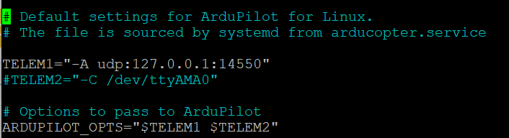
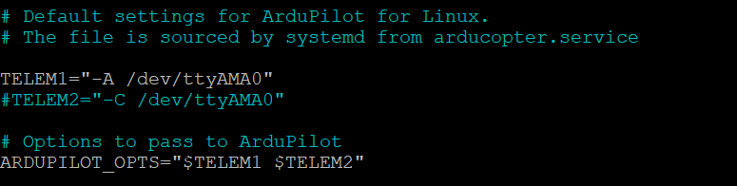
Step 6
Telemetry Configurations (Cont.)
6.3
Here we will change the telemetry settings for the Navio2 to change the baud-rate to match the baud-rate used for our telemetry radios. To do this, we are changing Serial 0 of the Navio2 from using UDP connection method to the telemetry UART port.
Change the text from left original to the right new
6.4
6.5
Press “Ctrl+x” to exit, press “y” to save, then hit enter
Finally, Reboot using the command , “sudo reboot”
Notes:
https://docs.emlid.com/navio2/ardupilot/installation-and-running

Slide 27
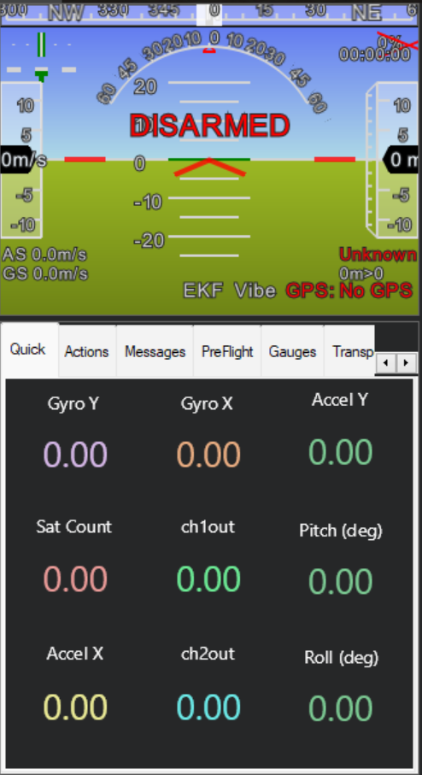
Ardupilot and Mission Planner Configuration
Avionics Kits
Telemetry Radio Kit
Power Supply
Internet Connection

Slide 28
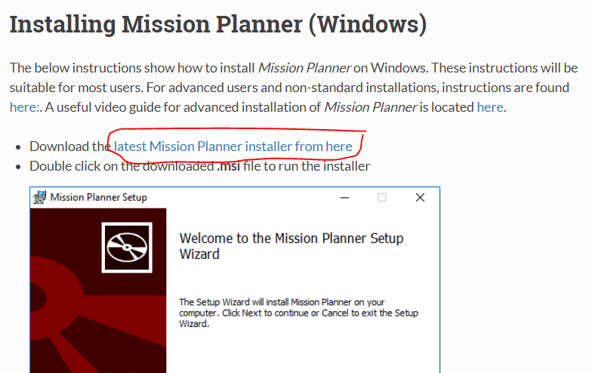
Step 0
Install Mission Planner
0.1
Mission Planner is our Ground Control Station which relays telemetry information to the user while the vehicle is in operation
0.2
Using the link provided below, go to the Ardupilot website and click the link https://ardupilot.org/planner/docs/mission-planner-installation.html this will begin downloading the installer to your computer.

Slide 29
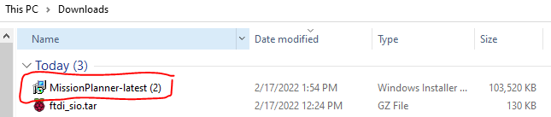
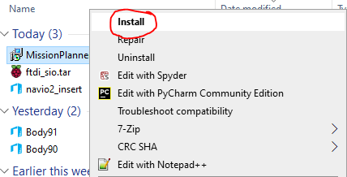
Step 0
Install Mission Planner
0.3
After downloading the installer, locate the file. This will likely be in your downloads folder or you can open it from your internet browser.
0.4
Open Installer by right clicking and selecting the “Open” or “Install” Option

Slide 30
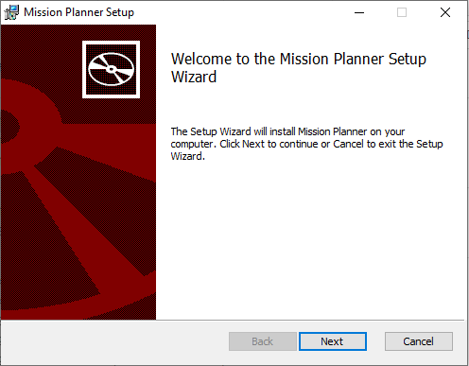
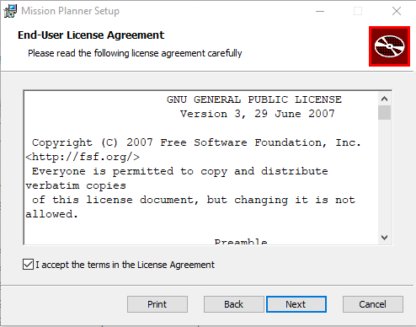
Step 0
Install Mission Planner
0.5
This will create a new program that will appear, follow these instructions
0.6
Press Next, then read the terms of agreement, agree to it, then select next

Slide 31
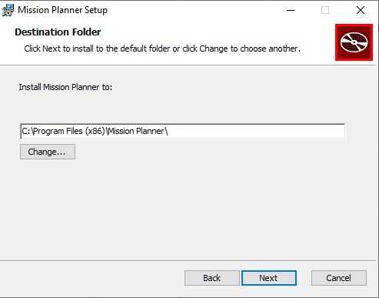
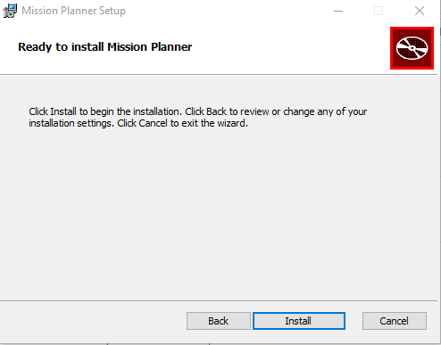
Step 0
Install Mission Planner
0.7
Select where you want to install Mission Planner on your computer or leave it at the default location selected. Then press “Next”
0.8
Confirm starting the installation by pressing “Install”

Slide 32
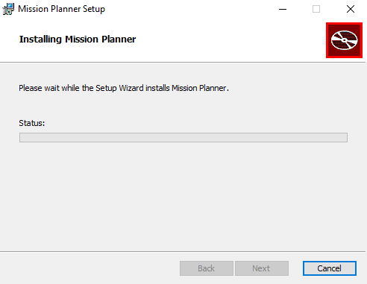
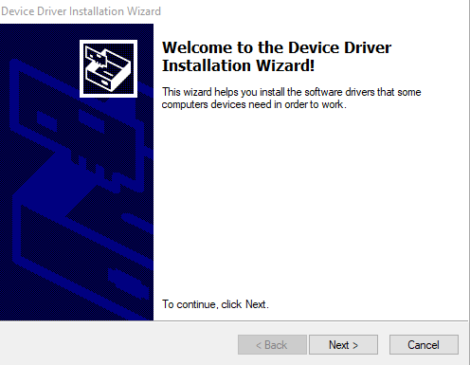
Step 0
Install Mission Planner
0.9
This will begin an installation that will finish when the status bar is filled. You might have another bar pop up asking for permission to install, allow the program permission for the installation to continue.
0.10
During the installation, some extra command consoles will open and close. This is normal. Additionally, you will get an installer for required drivers. These are required for interfacing with some telemetry components.

Slide 33
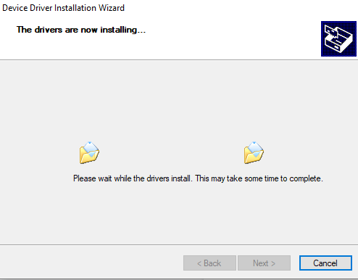
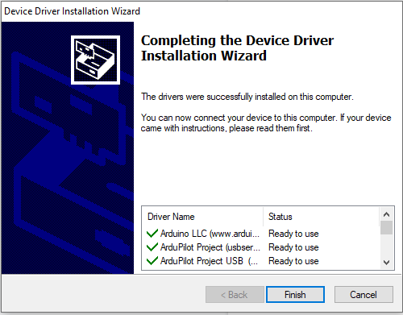
Step 0
Install Mission Planner
0.11
This will begin additional installations. You will note that the Mission Planner installation will not finish until you install these Device Drivers.
0.12
Once it is finished you will see the following screen. Press “finish” to close the document and the Mission Planner installation will resume progress.

Slide 34
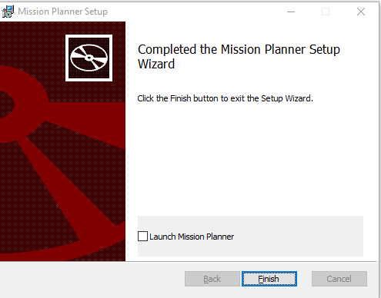
Step 0
Install Mission Planner
0.13
Once Mission Planner is finished you can click “finish” and have Mission Planner open after closing the setup wizard, or you can manually open it.

Slide 35
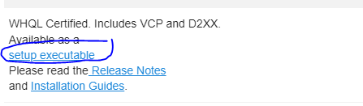
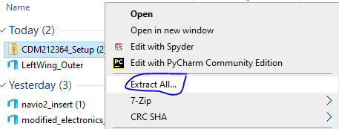
Step 0
Install Additional Drivers – FTDI Chips (cont.)
0.14
If you find your system does not find your Telemetry Radio when plugged in, you may need to install additional drivers. Please navigate to the following link: https://ftdichip.com/drivers/vcp-drivers/
Scroll till you see your operating system. For the purposes of this guide, we are using a Windows 10 system. So we would use the Windows (Desktop) option. If you look to the right under “Comments” you will see a hyperlink labeled as setup executable. Click it to download the Zip file containing the driver. The file should appear in your downloads folder.
0.15
Unzip the file by right clicking on it and selecting “Extract All”

Slide 36
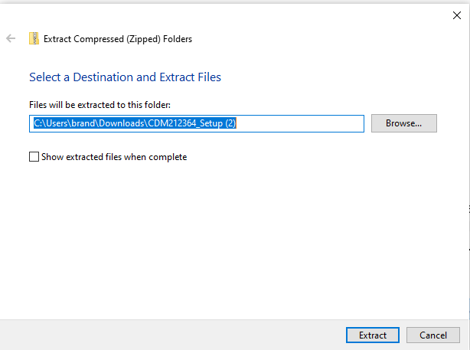
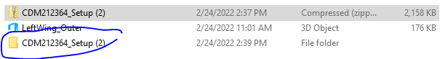
Step 0
Install Additional Drivers – FTDI Chips
0.16
Select the location, or leave the default location of where you want the extracted file to go. Then press “Extract”
0.17
Once it is finished extracting, you should see a new file folder where you selected the extracted files to be sent.

Slide 37
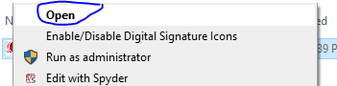
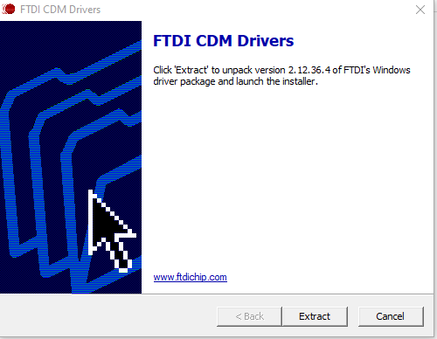
Step 0
Install Additional Drivers – FTDI Chips
0.18
Open up the folder, there will be an application file, either double click, or right click and select open.
0.19
This will open the installer. Select “Extract”

Slide 38
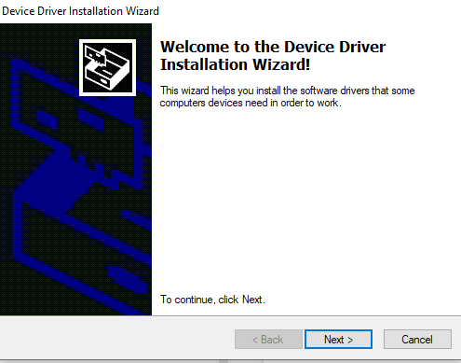
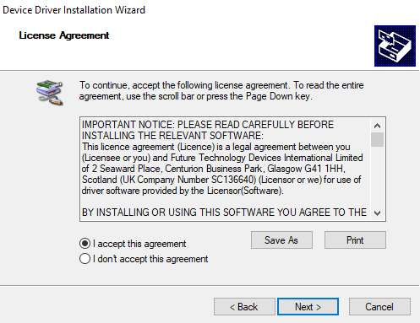
Step 0
Install Additional Drivers – FTDI Chips
0.20
This will perform the driver extraction and then open up another window for the installer. Select “next”
0.21
Read and Accept the license agreement and click “next”

Slide 39
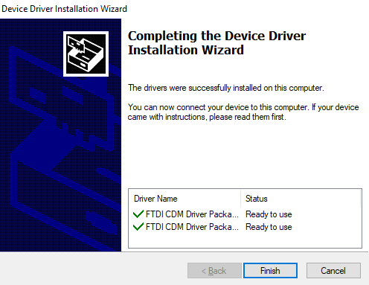
Step 0
Install Additional Drivers – FTDI Chips
0.22
This will perform the installation and once you are finished will bring you to a final window to show your drivers are ready to use. Select the “Finish” button.

Slide 40
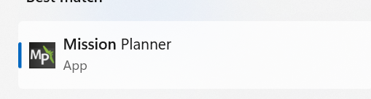
Step 1
Setup Mission Planner Telemetry
1.1
Depending on your Telemetry Radio, there is a possibility that the Mission Planner installation did not install the required drivers. So for our specific telemetry radios, we have found the drivers to be installed manually.
1.2
Open Mission Planner
1.3
Plug one of your telemetry radios into your computer. For the sake of this tutorial we will be doing one radio at a time, however you are able to configure both radios at the same time

Slide 41
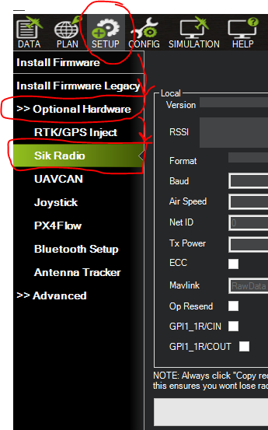
Step 1
Setup Mission Planner Telemetry
1.4
Navigate to the Telemetry Radio Section
In mission planner, click the “Setup” tab at the top then open the “Optional Hardware” Tab on the side bar followed by clicking the “Sik Radio” tab that appears in the dropdown of the “Optional Hardware” tab.
1.5
This opens the Radio configuration menu, which will allow you to adjust the configuration of your radio to fit your Navio2 setup.

Slide 42
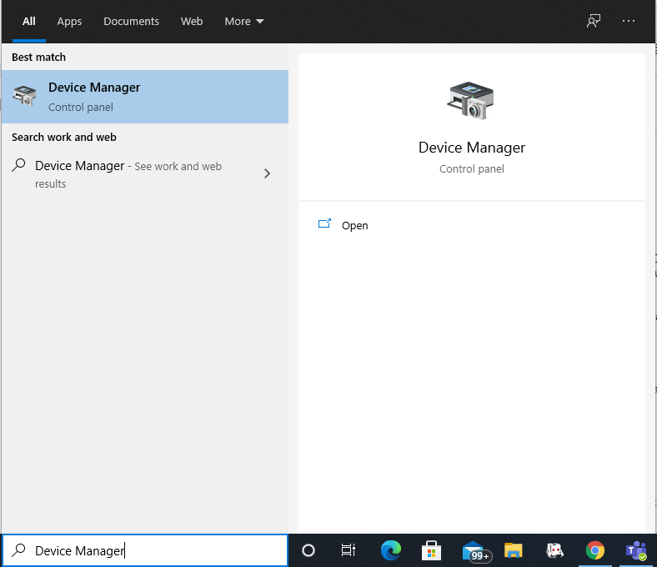

Step 1
Setup Mission Planner Telemetry
1.6
Find Telemetry Radio COM Port
In order to work with the radio you will need to know the COM port. To do this we can open “Device Manager” to find the currently in use COM ports. Enter “Device Manager” Into your search bar and open it.
1.7
The resulting program should look like the image below:

Slide 43

Step 1
Setup Mission Planner Telemetry
1.8
Our COM ports will be in the Ports tab highlighted in red above. If you click the drop-down box you will see the available COM ports.
1.9
Currently I only have one COM port active (COM6). In this case, COM6 is my radio port, if you have more than one COM port showing, try unplugging and plug the radio back in to see which COM port disappears and reappears, that will be your radio COM port.

Slide 44


Step 1
Setup Mission Planner Telemetry
1.10
In order to do this we must select the correct COM port and Baud rate in the top right corner , YOU WILL NOT PRESS CONNECT. Pressing connect will tell the mission planner to try talking to the Navio2, we are just trying to talk to the radio so we do not need to connect to it since it is already plugged in.
1.11
For COM port, select the drop down tab and select your COM port, remember we found the COM port for our radio.
1.12
Next we will select the baud rate, most radios default to 57,600 baud rate so we must select this to start. After we adjust the baud rate of the radio we will need to change our desired baud rate to the new baud we chose.

Slide 45


Step 1
Setup Mission Planner Telemetry
1.13
Now with the correct COM port and Baud settings we can read the configuration of the radio.
1.14
In the “Ski Radio” tab, press the “Load Settings” option at the top, this will read the current configuration of the radio and display it in the screen below.

Slide 46

Step 1
Setup Mission Planner Telemetry
1.15
Notice that only the Local settings were read, that is because we only have one radio connected which is the one connected to the ground control station.
1.16
Most of these settings we will not need to change from the default. Our main two changes are the “Baud Rate” and “Net ID”.
Baud Rate: The speed at which the radio communicates with the ground control station or navio2. (Radio to Navio2 and Radio to Ground Control)
Air Speed: The speed at which the radios communicate to each other. (Local to Remote)
Net ID: This is the identity for our radios, if there are multiple radios going it will be best to change the Net ID to a number different from every other radio, else you run the risk of communications affecting other people's vehicles. The default is 25 but you can select any number between 0 and 499. The settings for the radios MUST BE THE SAME.

Slide 47

Step 1
Setup Mission Planner Telemetry
1.17
Select the Baud rate drop down tab and select the new baud rate you desire (115,200).
1.18
Change NetID to a number that is different from the default 25, if you have multiple Radio Pairs, use a different ID for each pair. The Pairs must have the same ID.

Slide 48


Step 1
Setup Mission Planner Telemetry
1.19
Now click the “Save Settings” Option in the top, this will save the new configuration to the radio.
1.20
Now if you tried to click load settings again with the same baud rate (57,600) you will receive an error
1.21
This is because now your radio communicates at 115,200 baud, so you need to change your baud rate in the top right to your need baud rate

Slide 49

Step 1
Setup Mission Planner Telemetry
1.22
If you change the baud rate to 115,200 and click load settings you should see your radio appear, this time with the new baud rate.
1.23
In the “Ski Radio” tab, press the “Load Settings” option at the top, this will read the current configuration of the radio and display it in the screen below.
1.24
Now to do the second radio!

Slide 50

Step 1
Setup Mission Planner Telemetry
1.25
Unplug Current Telemetry Radio and Plug in Second Telemetry Radio
1.26
You will now do the same steps as before and give it the exact same settings as the first telemetry radio. Since this is a different radio, you will once again need to find the COM Port of this second radio.
1.27
Confirm Settings, ensure that both devices are using the 115200 baud, and that they both have the same Net ID.

Slide 51


Step 2
Connect to Navio2 Using Telemetry
2.1
Select the correct COM Port and Baud Rate, remember we changed our baud rate to 115,200
2.2
Press Connect, You will see a pop-up as the parameters load

Slide 52

Step 2
Connect to Navio2 Using Telemetry
2.3
If everything is correct, the pop-up should close and you will start seeing data flow into your left-side tabs including orientation and other data points. This means you are properly connected.

Slide 53

Step 3
Adjusting Parameters
3.1
One of the benefits of Ardupilot is the ability to adjust parameters and settings using your ground control station. To Do this, we will navigate to the “Full Parameter List”
3.2
In the top left, go to “Config” and then on the left side select either “Full Parameter List” or “Full Parameter Tree”
3.3
Select the Full Parameter List

Slide 54

Step 3
Adjusting Parameters
3.4
To find the parameter you wish to change, you can either scroll through the entire list of parameters (not recommended) or you can use the search bar on the right (recommended).
3.5
To change a parameter, first select the value cell of the parameter you wish to change. This will either pop up a list of options you can select, or allow you to enter in a new value. Notice in the “Options” Column to the right. This tells you the range of values you can enter.

Slide 55

Step 3
Adjusting Parameters
3.6
For example, look at the AHRS_GPS_USE parameter
3.7
Currently the value is “1” which represents the option “Use GPS for DCM Position”. Now if we want to disable this, we will change the value of 1 to 0. You will notice that after changing the value, the cell is green to indicate a change has been made.
3.8
Now we will submit the changes by pressing the “Write Params” Option on the right

Slide 56

Step 3
Adjusting Parameters
3.9
After it is written, if things are done correctly you will see a pop-up saying that the parameters were successfully saved.
3.10
And that is how to change parameters! Note: Make sure to change that parameter back to 1 if you were following these instructions.

Slide 57
Step 4
Setting Custom AHRS Orientation
4.1
Because we have the navio2 mounted in the rocket tube point straight down, our initial set orientation is incorrect and will confuse our system given that at launch the navio2 would believe it was moving backwards instead of upwards. We want our system to recognize moving backwards (negative x-acceleration) as position z-acceleration. To do this we have to rotate about our y-axis (pitch) with a set offset that cancels the current orientation of our Navio2. In this case, it is a negative 90 degree pitch. So how do we do that?

Slide 58
Step 4
Setting Custom AHRS Orientation
4.2
Go to Config -> Full Parameter List
4.3
In the search bar type AHRS_CUSTOM_PIT
4.4
Set the value to -90, this represents a negative 90 degree pitch to our orientation.

Slide 59

Step 4
Setting Custom AHRS Orientation
4.5
Right now, the pitch change does nothing, we must enable it by allowing the system to recognize our custom orientation offset
4.6
While still in Config -> Full Parameter List search AHRS_ORIENTATION

Slide 60


Step 4
Setting Custom AHRS Orientation
4.7
Set the value to 100, this enables the custom orientation we input.
4.8
Write the Parameters
4.9
Now if you hold the Navio2 point downward you should see the correct orientation for the rocket shown below when you have the Navio2 pointing Upward.

Slide 61
Step 5
Disable Auto-Disarm
5.1
So currently if you tried to arm the Navio2, it would arm then disarm after a few seconds. This is because the system has a set timer for when it expects you to start moving after you arm and if it doesn’t it will disarm. Since our rocket sits on the launchpad for varying amounts of time we want to be able to keep it armed.
5.2
Go to config -> Full Parameter List Search for DISARM_DELAY
5.3
Set value to 0. This disables the auto disarm.
5.4
Write Parameter to the Navio2

Slide 62

Step 6
Adjust Logging Parameters
6.1
So the Navio2 has the ability to save its information into data flash logs onboard the Navio2, so even if you lost connection with the Navio2 during its flight, you could still recover the logs from the Navio2 afterwards. We had a crash where the battery cut off, but we were still able to view logs of information that stopped right as the battery died meaning that we do not lose the entire flight during a failure such as power loss.
6.2
Go to config -> Full Parameter List Search for LOG_BITMASK
6.3
If you select the value it will open a check-box to select your desired logging options
6.4
Enable the following log types: ATTITUDE_FAST, ATTITUDE_MED, GPS, CTUN, IMU, CMD, COMPASS, IMU_FAST, IMU_RAW

Slide 63
Step 6
Adjust Logging Parameters
6.5
Disable LOG_DISARMED This is to ensure that we are only logging while our system is armed, preventing our system from producing extremely large data files while doing nothing.
6.6
Enable LOG_FILE_DSRMROT This will create a separate log for each instance that we arm the Navio2. Separates our launches so we can sort them easier.
6.7
Disable LOG_REPLAY This is for debugging issues with the Kalman filter and not necessary for most users. This is disabled by default generally.
6.8
Write Parameters

Slide 64
Step 7
Removing Fail-Safe Triggers
7.1
The purpose of this is to prevent the rocket from entering a fail-safe mode and disarming, which results in a loss of data. This is only for the rocket as you would not want a Drone or Rover to continue operating through fail safes.
7.2
Go to config -> Full Parameter List Search for THR_FAILSAFE
7.3
Set value to 0. This disables the Throttle failsafe that would activate if it losses RC Input. Because our system does not use a remote control, this would trigger constantly otherwise.
7.4
Write Parameter

Slide 65

Step 8
Calibrating IMU
8.1
In order to correctly identify accelerometer information, we must calibrate our system. This will involve placing the Navio2 in different orientations to record readings at each placement.
8.2
Go to Setup -> Mandatory Hardware - > Accel Calibration
8.3
Select the button for “Level Your Autopilot to set default Accelerometer Min/Max (3 axis). Follow its guide on how to place for each step then press the “click when done” for each step.

Slide 66
Step 8
Calibrating IMU
8.4
It will tell you each Orientation, set it in that orientation then press the “Click when Done” If you are using the Navio2 on its own outside of a casing, you may need to hold it in place while calibrating or using something to prop it up in specific orientations.

Slide 67

Step 8
Calibrating IMU
8.5
Level

Slide 68

Step 8
Calibrating IMU
8.6
Left

Slide 69

Step 8
Calibrating IMU
8.7
Right

Slide 70

Step 8
Calibrating IMU
8.8
Nose Down

Slide 71

Step 8
Calibrating IMU
8.9
Nose Up

Slide 72

Step 8
Calibrating IMU
8.10
Back

Slide 73

Step 9
Calibrating Compass
9.1
Open Mission Planner and go to Setup -> Compass
9.2
Click on “Start” for Onboard Calibration

Slide 74

Step 9
Calibrating Compass
9.3
Begin moving the Navio2 in all directions and orientations. You will see the first two bars start to fill as the compass calibrates.
9.4
Once both are finished you will be prompted to restart the navio2 which you can do by pressing CTRL+F and clicking the “reboot Pixhawk” option

Slide 75

Step 10
Prefetching Maps
10.1
While connected to the internet, your ground control will show a high-quality map to reference your location, however if you are in an area without internet access your map will not be as good. To fix this, we will download a portion of the map that we plan to fly to maintain high quality visuals.
10.2
Go to Plan

Slide 76

Step 10
Prefetching Maps
10.3
Find where you plan to fly/launch/operate your navio2

Slide 77

Step 10
Prefetching Maps
10.4
Zoom out enough to cover your potential flight area and then some

Slide 78

Step 10
Prefetching Maps
10.5
Right click and go to Map Tool - > Prefetch

Slide 79

Step 10
Prefetching Maps
10.6
It will say “ No ripp area defined, ripp displayed on screen?”. Select yes, this will prefetch the entire map shown on your display

Slide 80

Step 10
Prefetching Maps
10.7
Select your desired zoom, the larger the number the longer it will take as it is zooming in and saving the more detailed zoomed images. A good option is 17 for most flights

Slide 81

Step 10
Prefetching Maps
10.8
Once it is finished with the download you now are able to have access to the map data even if you are not connected to the internet as long as you are operating within your prefetched area.

Slide 82


Step 11
Test Arming and Disarming
11.1
Now we will run a quick test to ensure we are able to arm and disarm the system
11.2
Go to Data and then the actions tab in the bottom left
Now press the “Arm/Disarm” Button. This is to force arm, you might get warnings telling you that the rocket isn't ready. This is fine as we generally will not have all the arming conditions meant as the rocket will not have radio connection so it will not have a radio or throttle. If you are inside testing this you also will not get a proper EKF information or GPS information so those are also normal.
11.3

Slide 83


Step 11
Test Arming and Disarming
11.4
When it is armed you will see the “ARMED” pop up in the top left box before disappearing, your system is now armed.
11.5
Currently while armed your system should be logging data and saving it. You can move your system around for acceleration info. When you are done messing with your Navio2, disarm it by pressing the same button. You will know it's disarmed with the “Disarmed” appearing in the top left.

Slide 84

Data Extraction and Analysis
Avionics Kit
Power Supply
WinSCP – Installation Instructions Attached
Flash Drive – Alternative Data Extraction
Internet Connection

Slide 85
Step 0
Downloading Required Software
0.1
If you plan to download your data from the Avionics to your computer using a wireless connection.
Get WinSCP - https://winscp.net/eng/index.php WinSCP is a software to download files from other devices on the same Wi-Fi network. We can use this to download the Dataflash logs much faster than through the radio and save them in specific directories with desired naming conventions.
0.2
Get the IP Address of your Raspberry Pi/ or the Hostname

Slide 86

Step 1a
Importing Logs using WinSCP
1a.1
Open WinSCP You will get a terminal like this, it’s similar to Putty in which you must enter the IP address of the Navio2 along with the username and password (username: pi, password: raspberry). Or if you have the hostname (Default is “navio”), you can just enter that in place of the IP Address. Once you log in you will be able to look through all the files available on the Navio2.

Slide 87

Step 1a
Importing Logs using WinSCP
1a.2
Once you have logged in to WinSCP, navigate to where the Dataflash logs are stored on the Navio2. Go to /var/lib/ardupilot/logs/ to find them.
The logs are made in order, so “00000001.BIN” was made first, and “00000013.BIN” was made last.

Slide 88

Step 1a
Importing Logs using WinSCP
1a.3
Click on the BIN file you wish to download to your computer and click the Download button.
1a.4
Once you have clicked the download button, the below pop-up will appear allowing you to specify the name and location of the file you want to transfer. I have selected the file to be downloaded in my Documents folder for easy access. You then can name the file whatever you want as long as at the end you add the “.BIN” this will make sure the file is transferred as a BIN file. Select OK when you are ready to transfer.

Slide 89

Step 1a
Importing Logs using WinSCP
1a.5
After hitting “OK” the file will download and you can then view it on your own computer in the location you saved the file. Once you have the BIN file downloaded you can disconnect from WinSCP as you have the files you need. From here you can now look at the results of the launch with mission planner or UAV Log Viewer.

Slide 90
Step 1b
Importing Logs Using a Flash Drive
1b.1
This is an alternative method to the WinSCP method discussed in other documentation to circumvent issues connecting the Navio2 to an internet network.
First Connect a Monitor and Keyboard to your Navio2 and power it on.
Make sure you have a formatted flash drive with the “FAT” format style and have created a folder labeled “Logs”
1b.2
The SD cards we provide should have a usb folder with them, so you should not have to format the folder. However, if you need to create a folder, follow the instructions below
Log in to your Raspberry Pi using the standard Username and Password (pi/raspberry)
Create the USB Directory using the following command "sudo mkdir /media/usb"
Added permissions to the folder "sudo chmod 775 /media/usb"
You should now have a folder we will use as our USB directory

Slide 91

Step 1b
Importing Logs Using a Flash Drive
1b.3
Now we must find the address of our flash drive. Each device has its own address that we need to know in order to interface. To confirm which address is our flash drive. We will first check the available addresses without the flash drive plugged in. Then we will plug in the flash drive and check addresses again. This way the new address we know corresponds to our flash drive.
1b.4
Without the flash drive plugged in, enter the command "ls -l /dev/disk/by-uuid/"

Slide 92

Step 1b
Importing Logs Using a Flash Drive
1b.5
Now insert the flash drive and run the command again
We can see that the new ID has an address “../../sdc1” in this case, “sdc1” is our address that we will want to take note of.
1b.6
1b.7
Now we want to connect to our flash drive using the mounting command "sudo mount /dev/*** /media/usb -o uid=pi,gid=pi“
In our case, the “***” will be “sdc1” the address of our flash drive.

Slide 93

Step 1b
Importing Logs Using a Flash Drive
1b.8
Now we can view the available logs that we want to export to our flash drive using the command “cd /var/lib/ardupilot/logs” followed by the “ls” command to list all files
If you want to just copy one file (Say the first log “00000001.BIN”) “sudo cp /var/lib/ardupilot/logs/00000001.BIN /media/usb/Logs”
1b.9
1b.10
If we want to download all available logs, use “sudo cp -R /var/lib/ardupilot/logs /media/usb/Logs”
When you hit enter this might take a second depending on how many logs you have. give it some time

Slide 94
Step 1b
Importing Logs Using a Flash Drive
1b.11
Now that we have our data downloaded, we will unmount our flash drive.
Use the command "sudo umount /media/usb“ You should always unmount the flash drive after you are done, otherwise if you plug it back in the address will have changed.
1b.12
Now you should have a flash drive full of your desired logs in the form of BIN files!

Slide 95

Step 2
Viewing BIN Files in UAV Log viewer
2.1
UAV Log viewer is a Web-Based file viewer for Ardupilot flight logs. You do not need to download any additional software to use it. It also has the capability of creating CSV files of selected flight data for you to look at in programs such as Excel
2.2
First Navigate to the site : https://plot.ardupilot.org/#/
2.3
You will see a Page like this with the option to load in either .tlog or .bin files

Slide 96

Step 2
Viewing BIN Files in UAV Log viewer
2.4
Click the box to open up a file browser to select your desired bin file you wish to view
2.5
Once you have selected your file, it will load it and show you a map containing your flight data along with the available data you can plot.
2.6
If you select the “Plot Individual Field” it will list the groups you can view such as IMU data.

Slide 97

Step 2
Viewing BIN Files in UAV Log viewer
2.7
For the Single-Stage Rocket, we are focused on three sets of data, Z-Acceleration, Altitude, and Z-Velocity.
2.8
Open up the Plot Individual Field and scroll to the “IMU” tab and open it. You will see all IMU parameters listed there.

Slide 98

Step 2
Viewing BIN Files in UAV Log viewer
2.9
If you Select the AccZ (Z-Acceleration), it will create a plot on the right side.
If you only wish to look at the plot, you can select the “X” on the map to close it in the lower half of the screen. This will remove the map and only show you plots.

Slide 99

Step 2
Viewing BIN Files in UAV Log viewer
2.10
Now lets add the other two data points: Altitude is in the NKF1.PD parameter (Representing Position in the downward direction) Velocity in the Z-Axis is NKF1.VD (Representing Velocity in the Downward Direction)

Slide 100

Step 2
Viewing BIN Files in UAV Log viewer
2.11
With all three selected, you should have a Log viewer single plot with all data on it. You may notice multiple Y-Axis bars, these are representing the different Y-Values for each plot item.

Slide 101


Step 2
Viewing BIN Files in UAV Log viewer
2.12
Now if you hold left click and drag around the center of the graph, you can select a zoom area to for the data. When you let go, it will now zoom in to the highlighted area.

Slide 102



Step 3
Exporting Data from UAV Log Viewer
3.1
If you'd like you can now take screen shots of this zoomed portion using the save as a .png option in the top right
3.2
Or, if you'd like to save these three data sets as a CSV, you can select the download as a CSV option. Note this will save the entirety of the three data sets, not just your zoomed in portion.
3.3
Once you have downloaded the data set, it will appear with a simple name “data.csv” in your downloads folder. From here you can rename it and open in excel.

